Slide 1

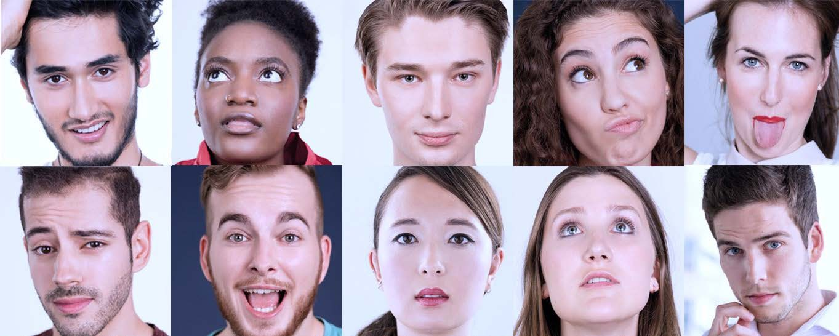

Control of the ball in the tube
-
Control System Design – T5 Robotics
Team:
Ankit Pandey
Tigran Pletser
Emmanouil Stivaktakis
Julien Van Delft

Slide 2
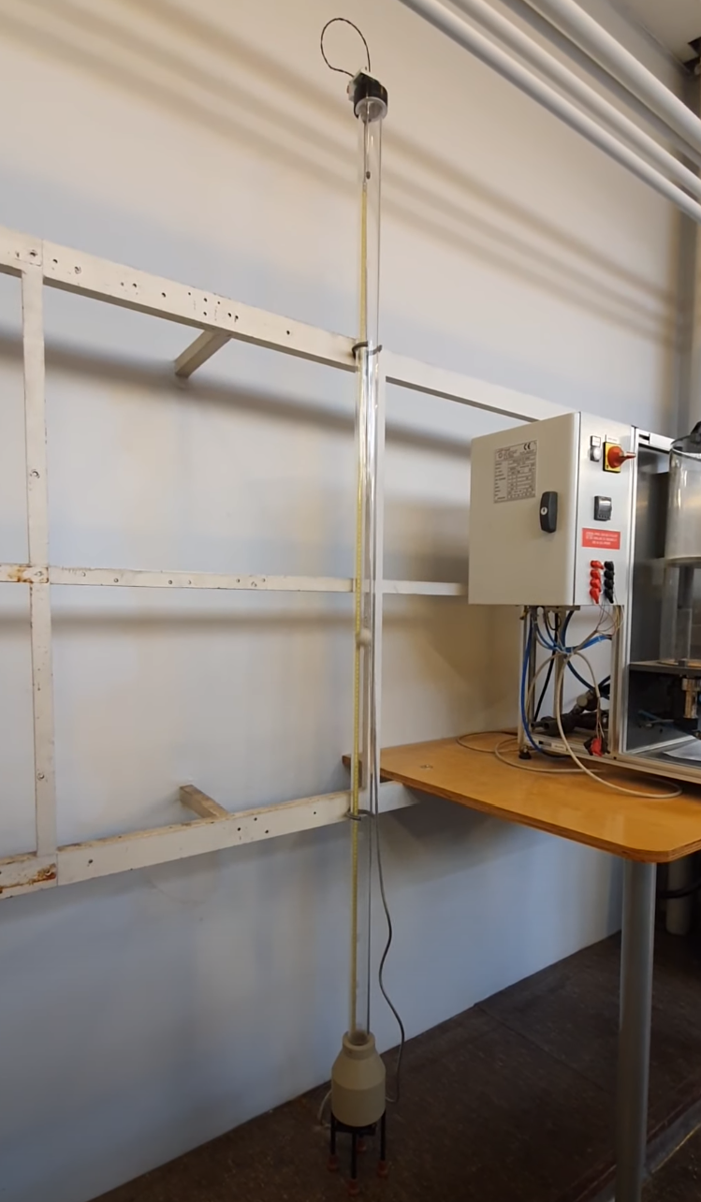
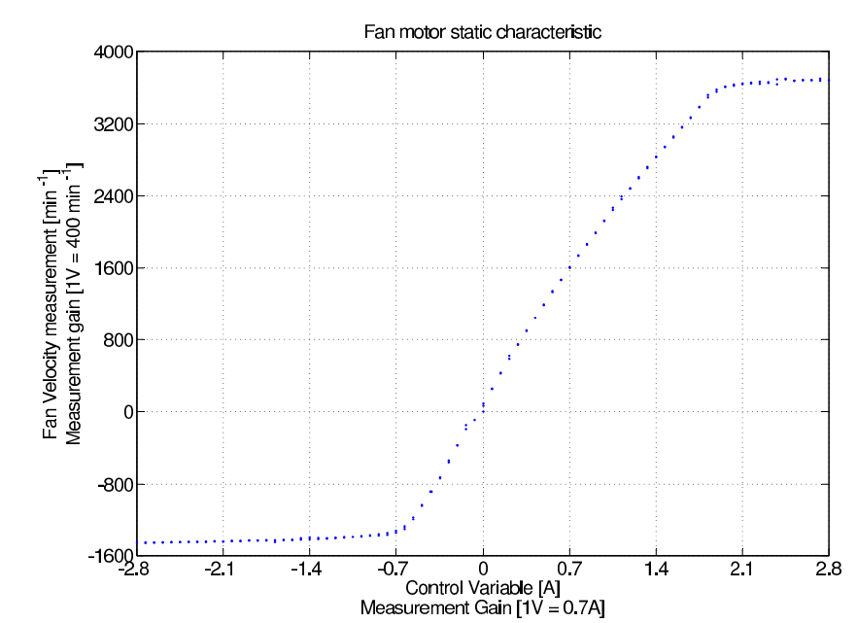
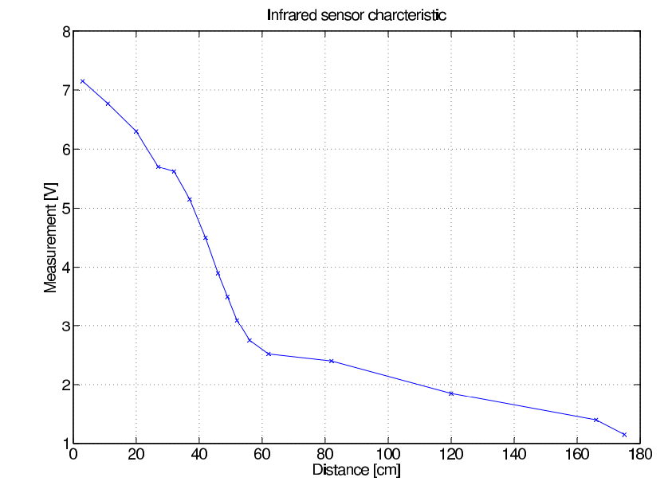
Plant description
Components:
DC current driven motor
Fan attached to the motor
Tachometer to measure velocity
Linear between -1400 rpm and 3600 rpm
Infrared sensor to measure the ball position
Two linear zones, 0 to 60cm and 60 to 180cm

Slide 3
Requirements
Basic requirement
Stabilisation of the ball at a fixed position without any steady state error
More advanced requirements
Switch between two different points with a maximum of 1 cm overshoot
Switch between two different points with a maximum of 1 cm overshoot in maximum 2 seconds.

Slide 4
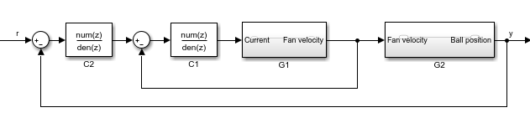
Methodology
Using cascade control method, we transform a system with 1 input/2 ouputs into 2 SISO systems. And by using the Gray box method (with the equations on the next slide), we find those 2 subsystems :
Current-Motor system :
current as input and fan velocity as output
Fan-Ball system
fan velocity as input and ball position as output
Inner loop and outer loop will be identified, validated with the real plant and controlled

Slide 5
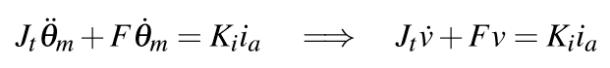
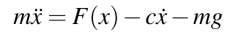
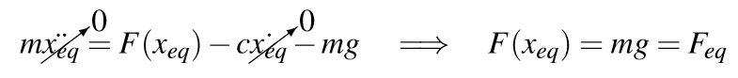
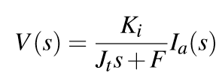
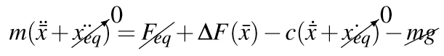
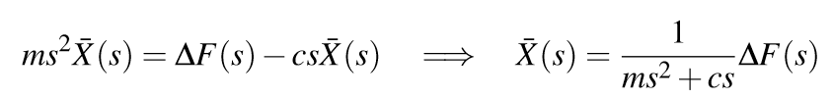
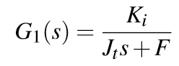
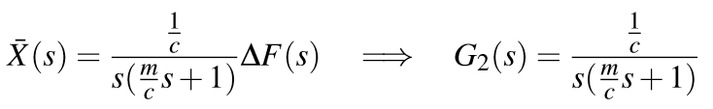
Physical relationships
Current-motor system
The current-motor system has the form of a simple first order system
Fan-ball system
The fan-ball system reduces to an integrator and a first order system
But the pole has low impact on the system so the second system can be approximated by an integrator with a gain

Slide 6
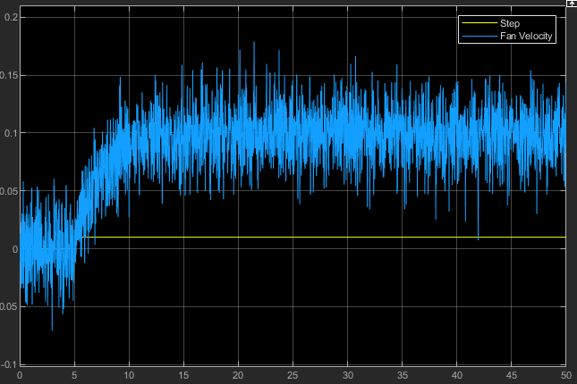
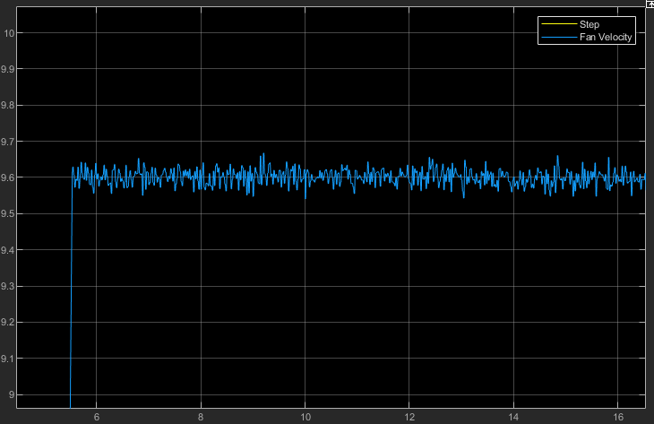
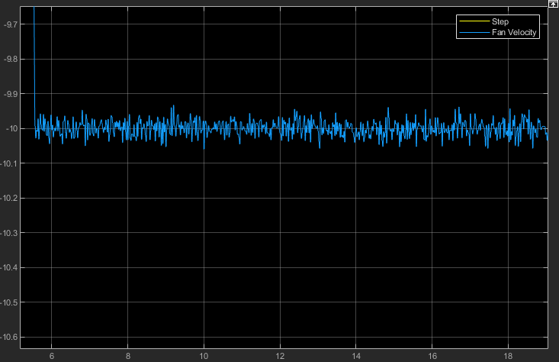
Inner loop - Identification
Response to a small step
Response to a huge positive step
Response to a huge negative step
No dead zone
Upper saturation to 9.6V or 3840 rpm
Lower saturation to –10V or -4000rpm

Slide 7
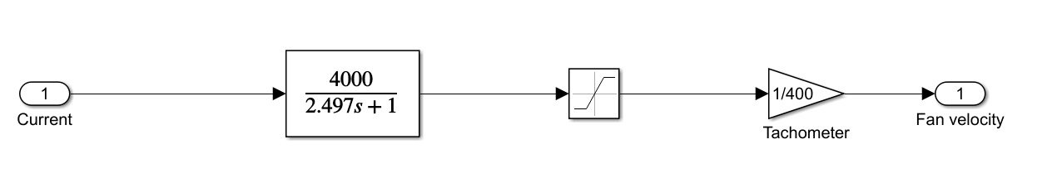
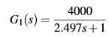
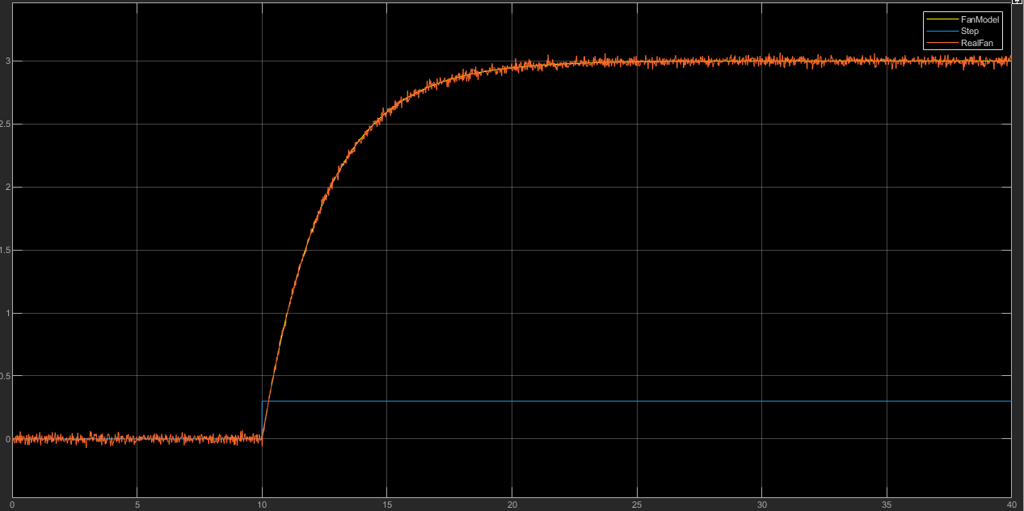
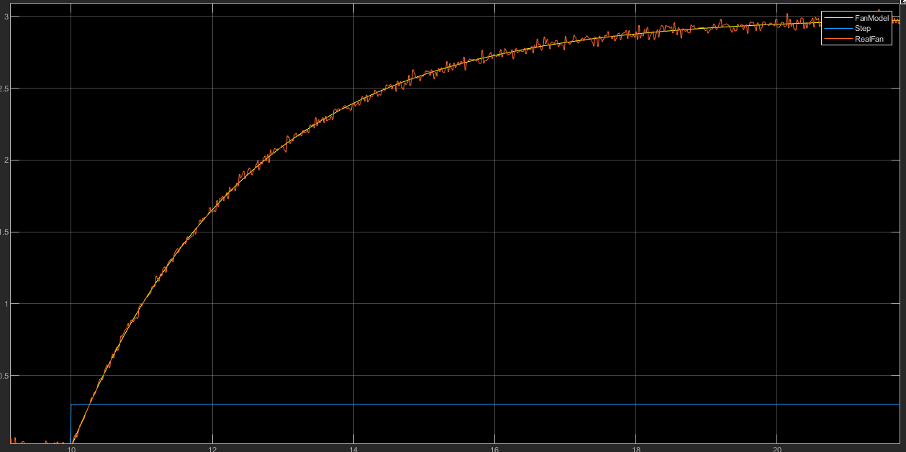
Inner loop - Identification
Identified transfer function
Current into Fan velocity
Validation

Slide 8
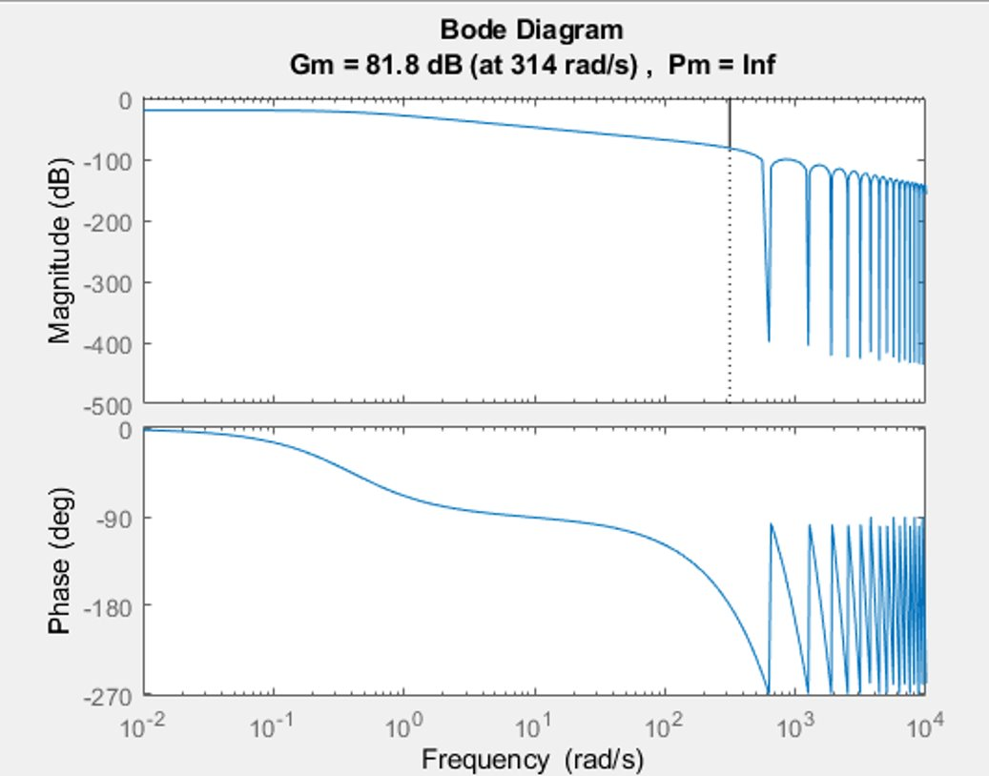
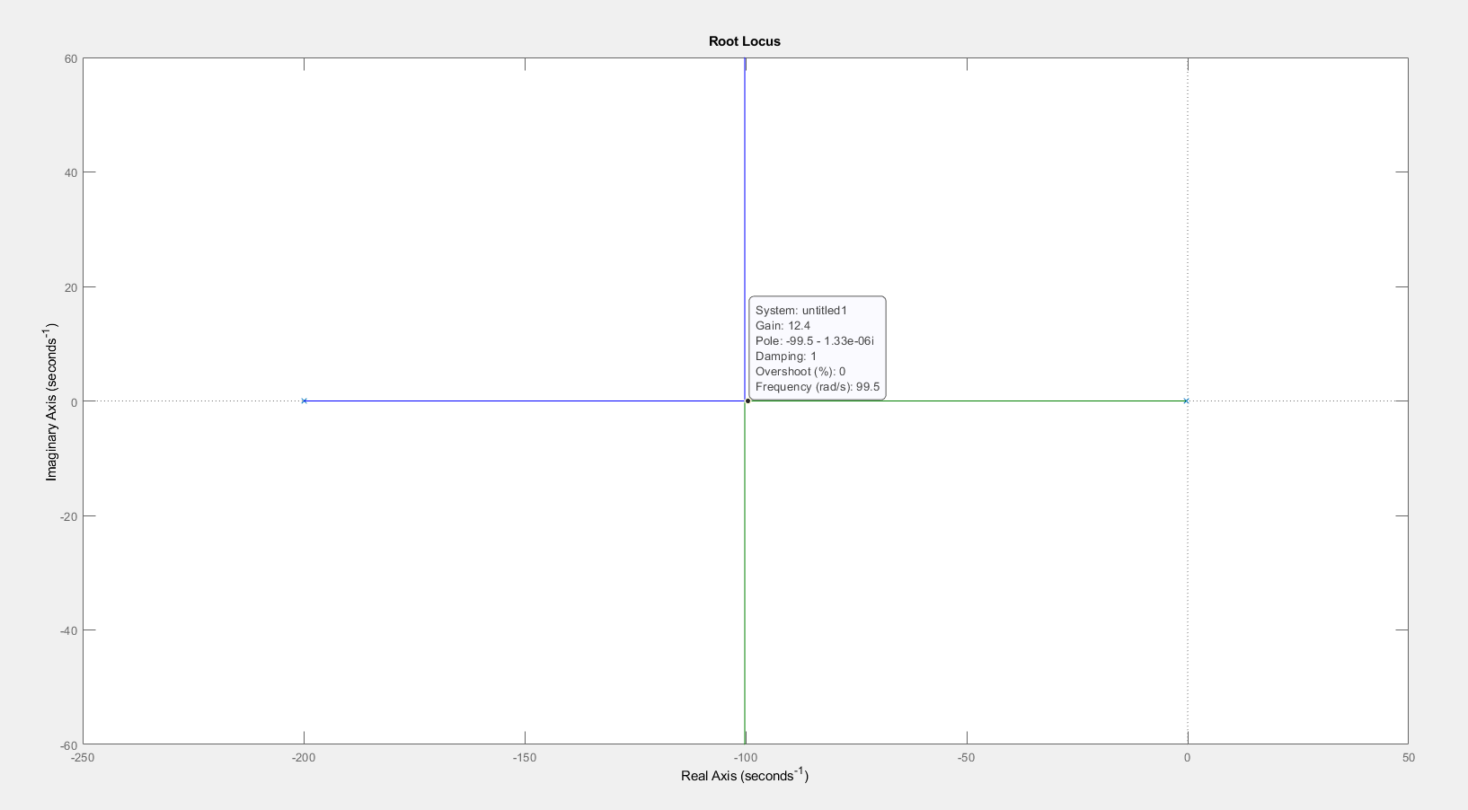
Inner loop - Regulation
Main characteristic :
Reacts fast to the input
Static error can be neglected
=> Proportionnal regulation
By plotting the Bode diagram of the sub-system (including real ZOH)
With Pade' approximant and a sampling time of 0.01, we find this root locus
We find a max Kp without overshoot of 12.4
We find a maximal gain of 12300

Slide 9
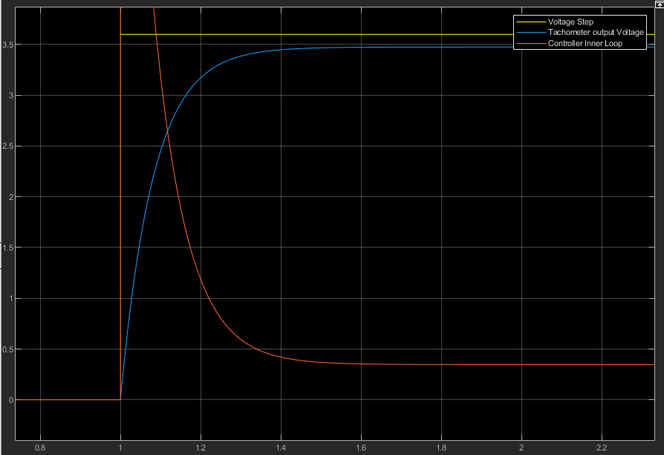
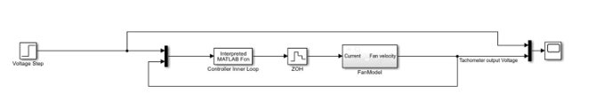
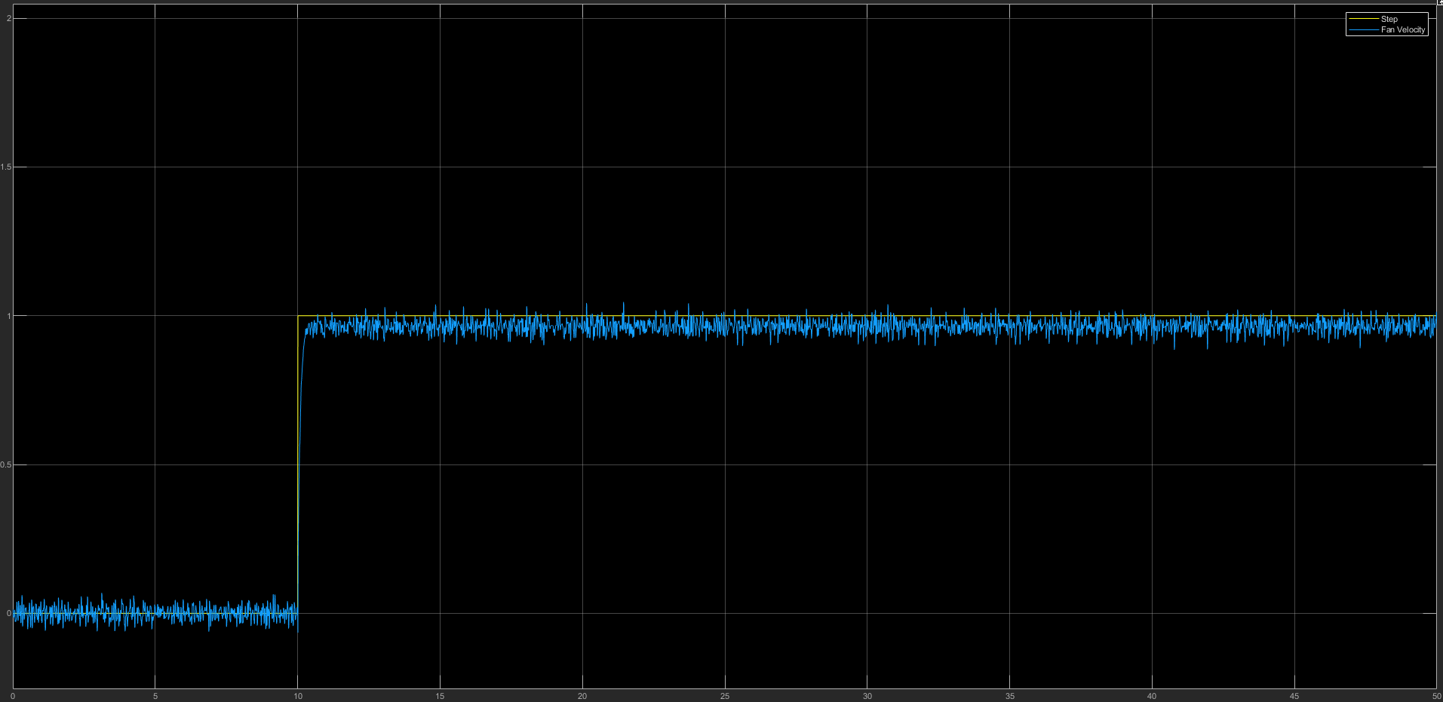
Inner loop - Regulation
By testing, we find that the equilibrium point of the ball is 6,2V which leads to around 6,4V input as the static error is non-zero
The maximum gain while avoiding the motor saturation (10V) is then Kp = 2.777
We used a gain of 2,775 which gives us a settling time of about 0,25s
We then use our regulation on the real plant and find that it matches with our model

Slide 10
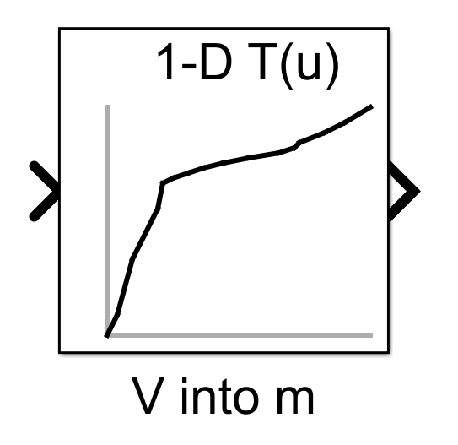
Outer loop – infrared sensor modelisation
2 different linear zones
Between 0m and 1.2m (in the tube) or 1.2V and 2.5V
with a slope of 1.083
Between 1.2m and 1.8m or 2.5V and 7.3V
with a slope of 8.03

Slide 11
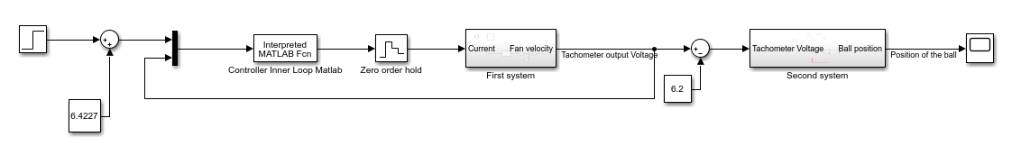
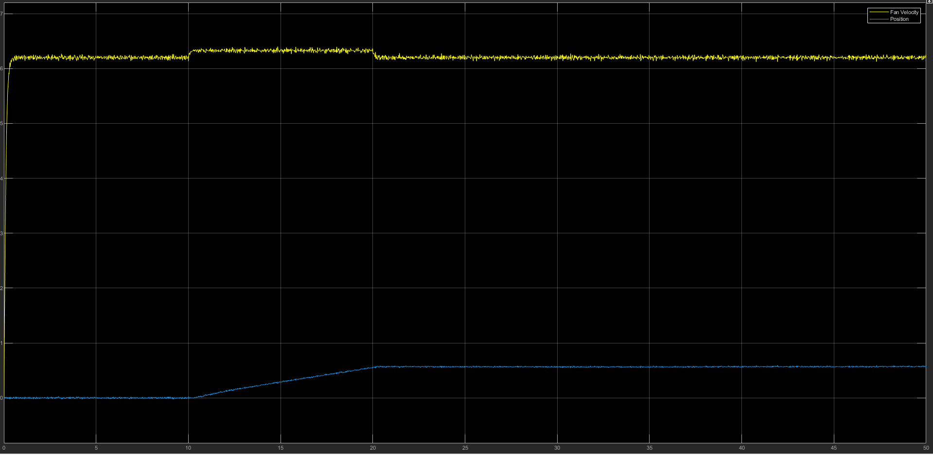
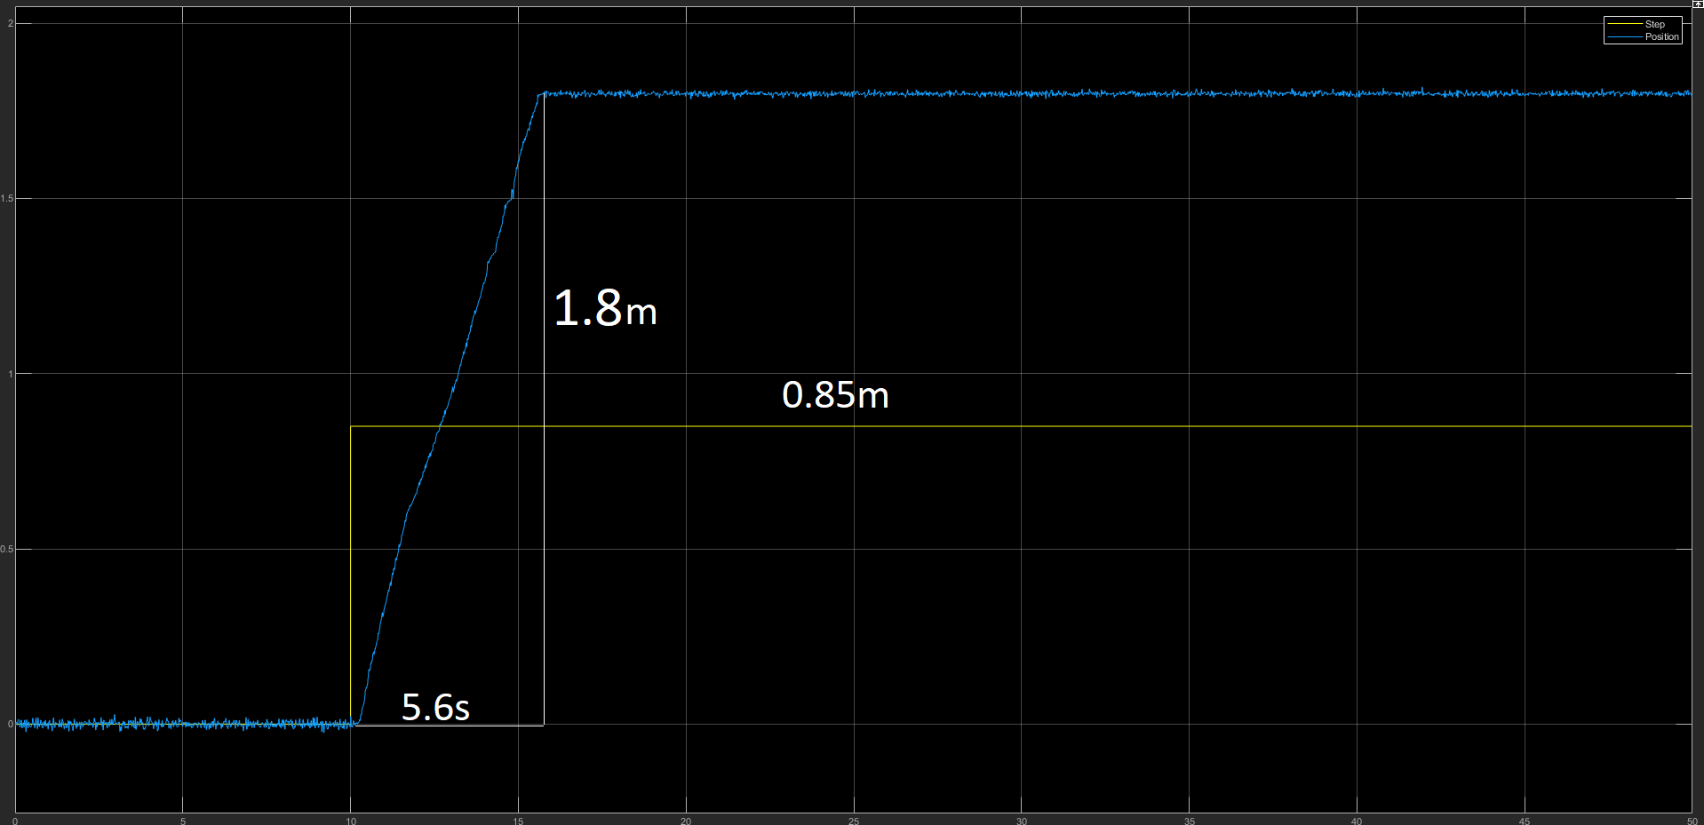
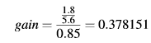
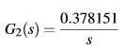
Outer loop - Identification
We want study the variation of the ball around the equilibrium
Introducing a step of 0.85m (1V) above the equilibrium value
The equilibrium point is 6.2V at the input of the second system

Slide 12
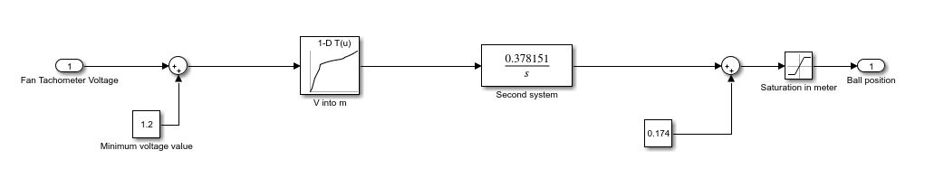
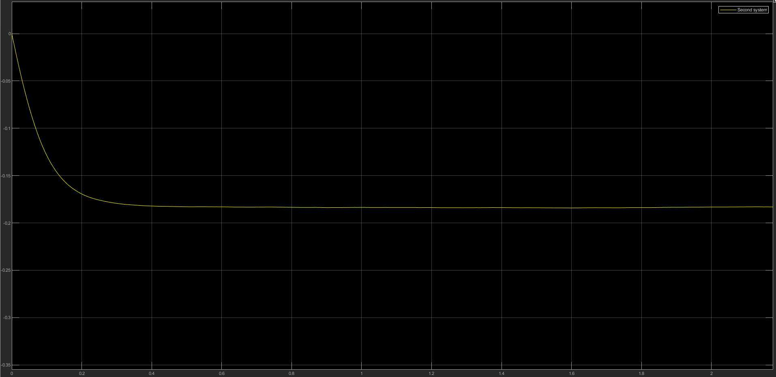
Outer loop - Identification
0.174 is an experimental value to cancel the negative offset when the fan is rising to the equilibrium speed
Saturation at the output are 0m (bottom) and 1.8m (top)
1.2V is the offset value given to 0m

Slide 13
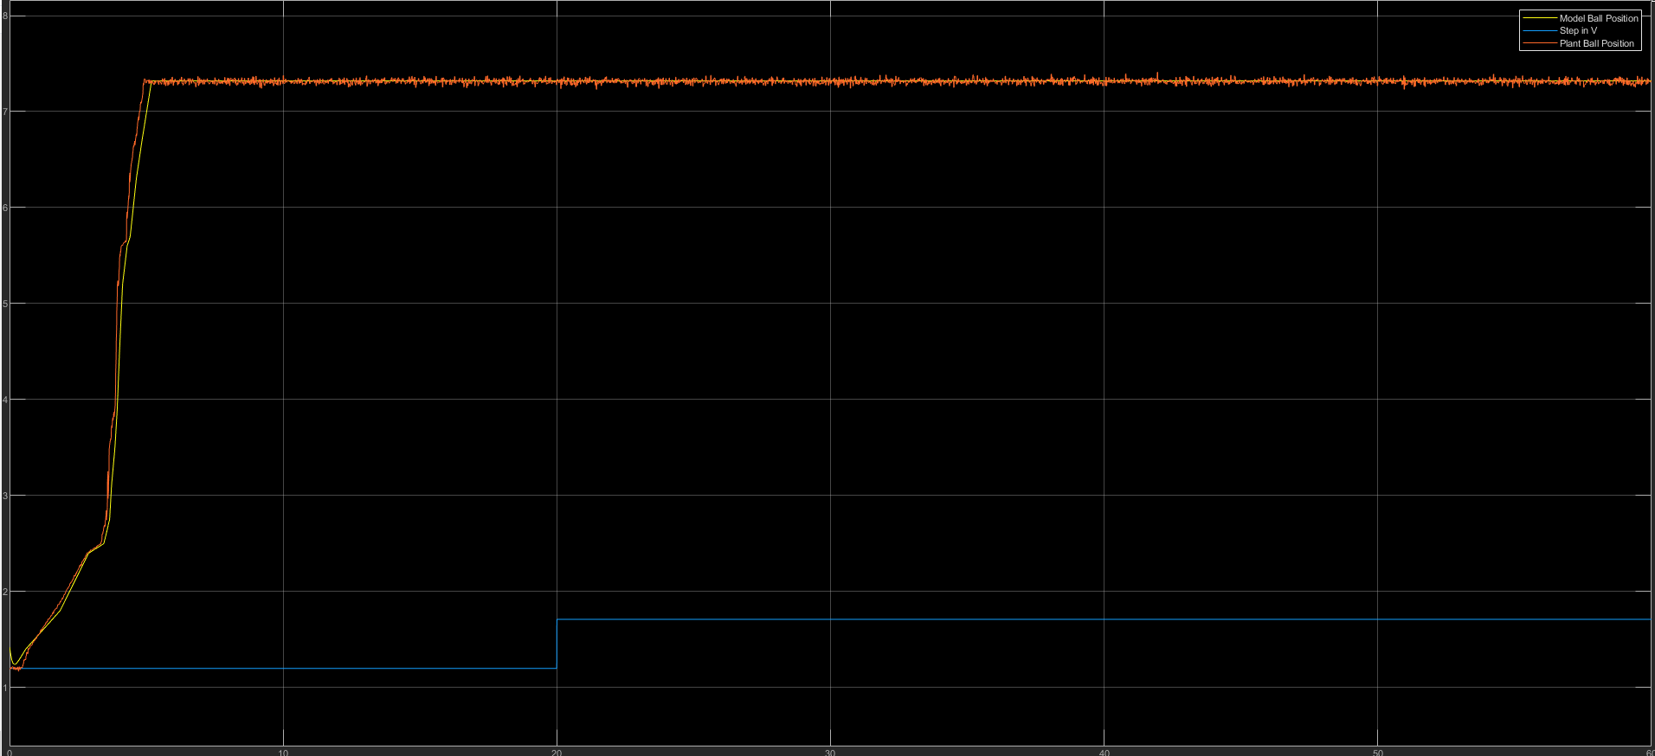
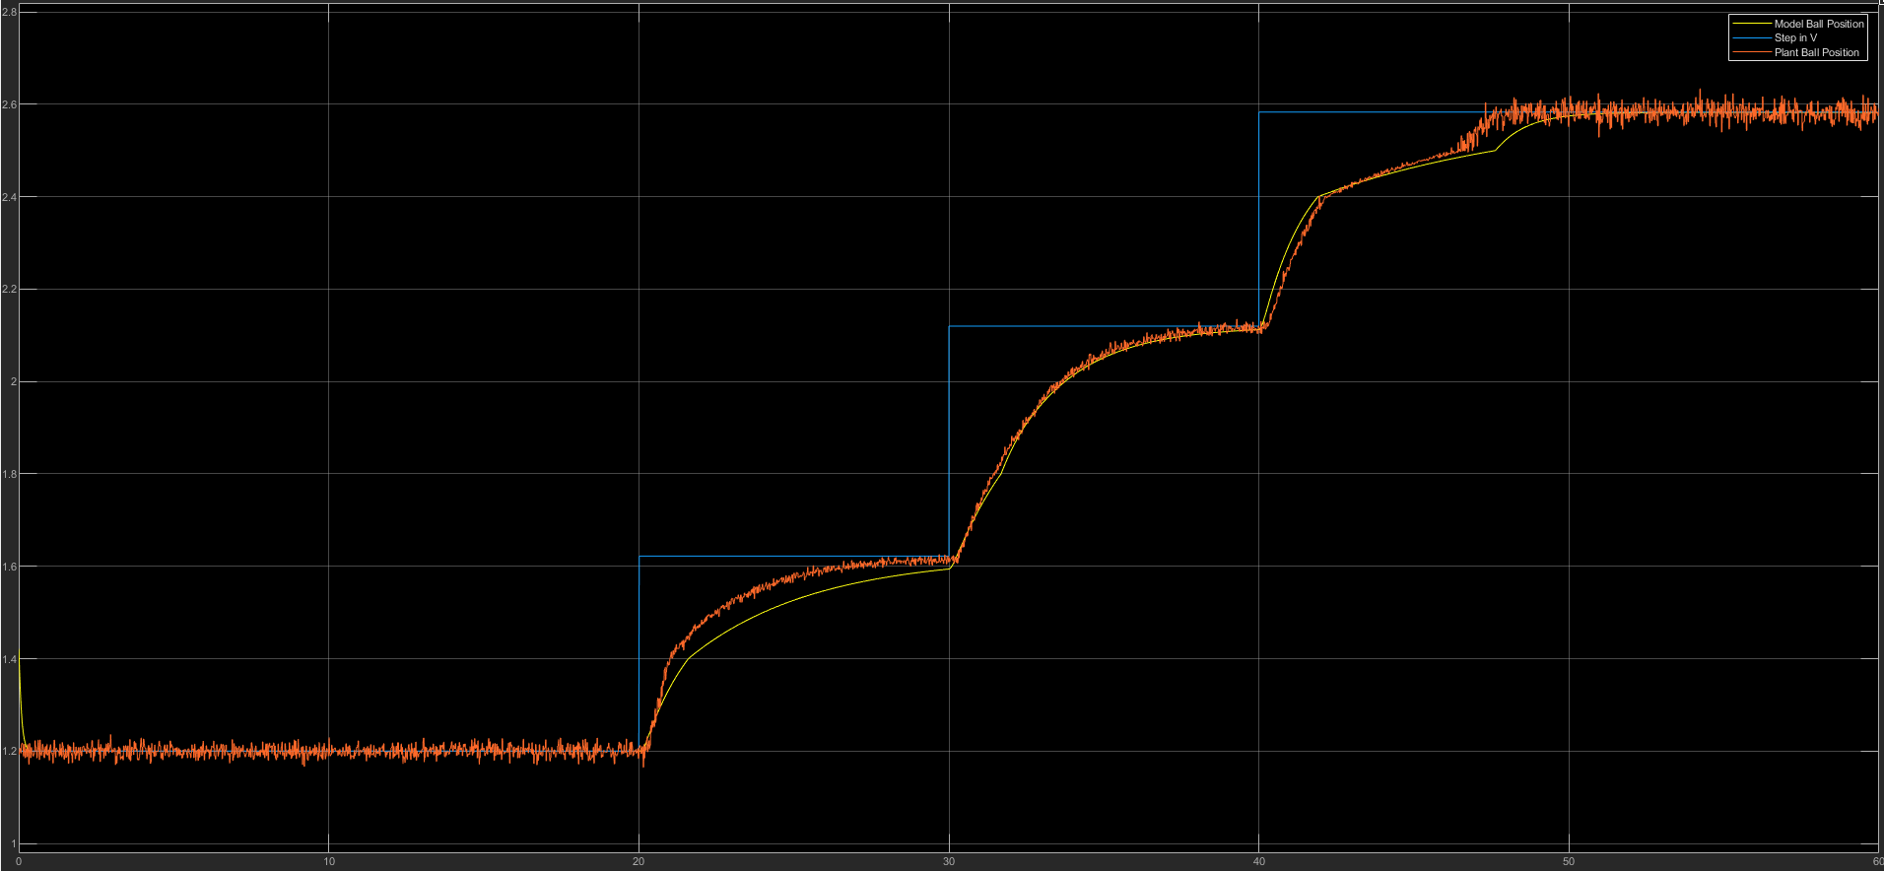
Outer loop - validation
Comparison of the outer loop model with the real plant outer loop both in open loop and closed loop
Closed loop with a Kp of 1 for testing
Excellent match between the model and the plant

Slide 14
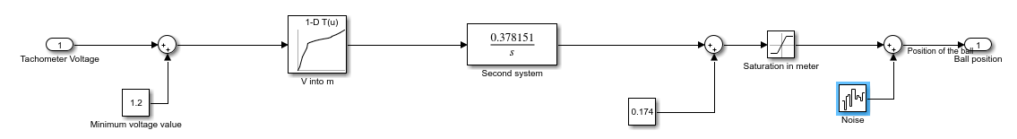
Introduction of noise in the model
In the real plant, both sensors are producing noise
Noise is added in the model to simulate more accurately the plant

Slide 15
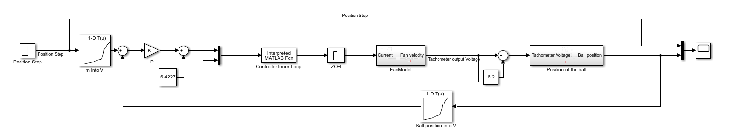
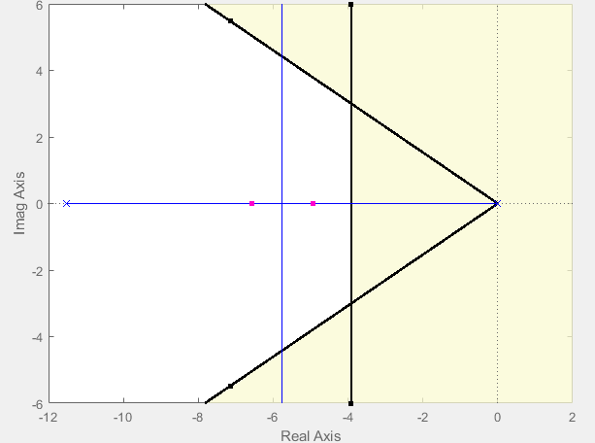
Outer loop – P regulation
The second system is already an integrator ==> A P-regulator is enough to acheive basic requirement
Rltool is used on the outerloop to find a P-regulator that could maybe satisfy advanced requirements in the upper zone
Settling time of 2s
1cm/(180cm-120cm) = 1.666% overshoot (upper zone)
Kp = 0.9821 is a good compromise between a low settling time and no overshoot

Slide 16
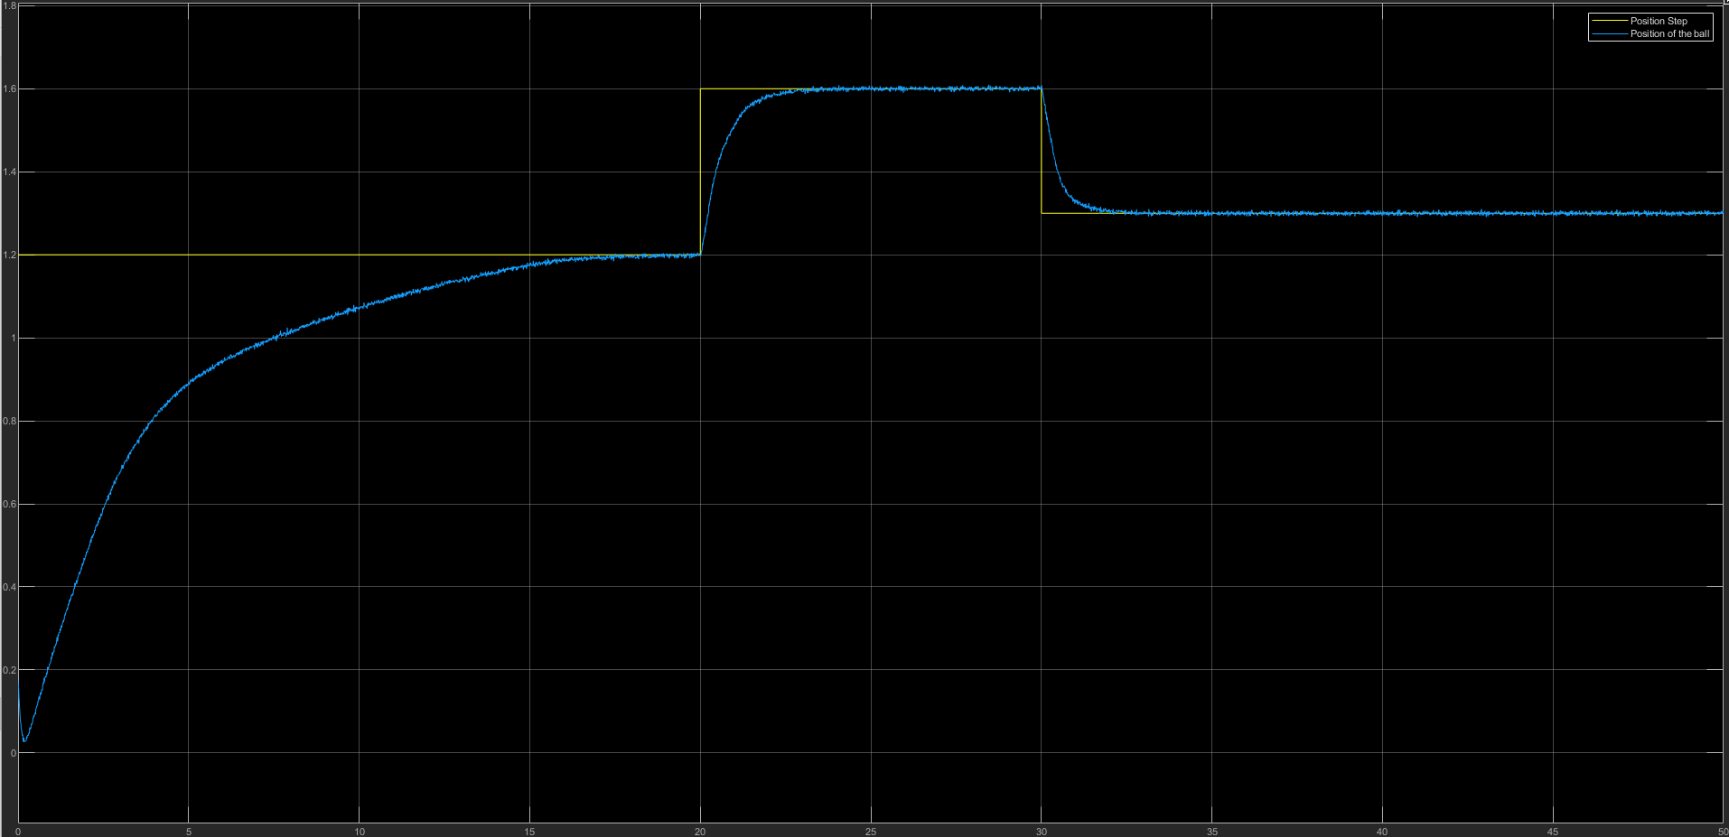
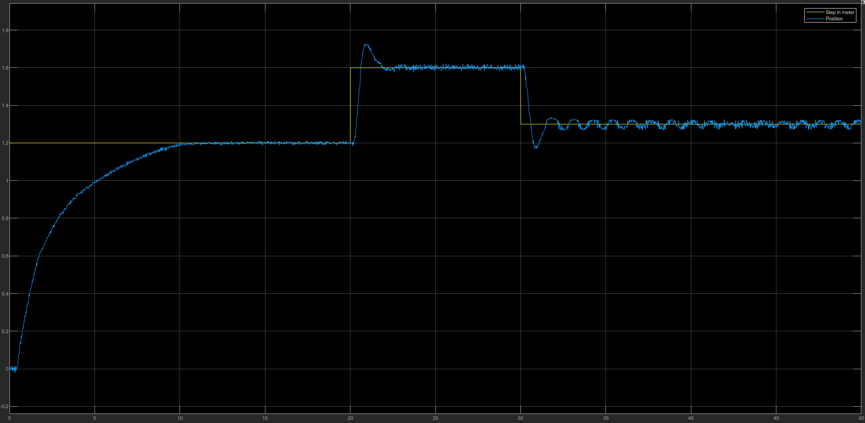
Outer loop – P regulation
Test of the regulation on the model
Test of the regulation on the plant
It fulfills the requirements for the model but not for the real plant probably due to the simplification we made on the form of the second model

Slide 17
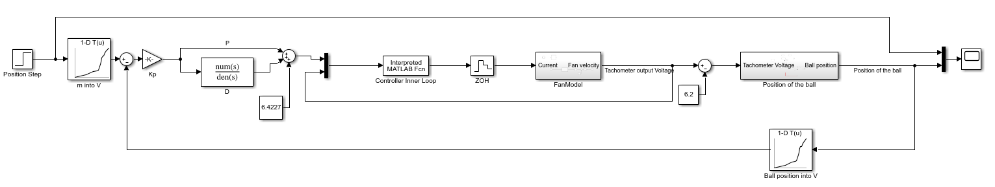
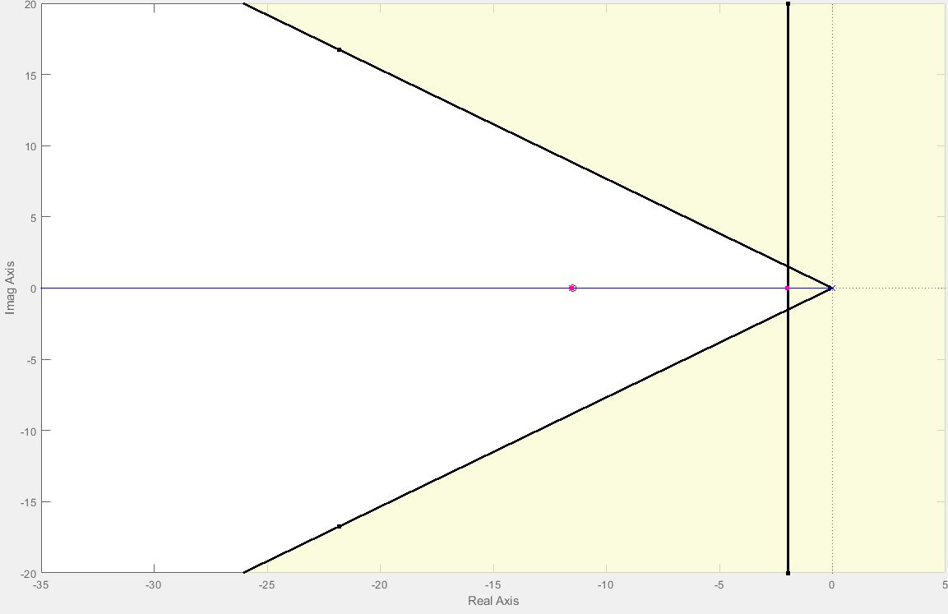
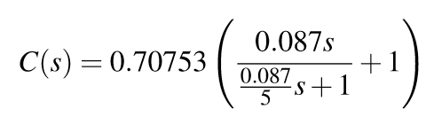
Outer loop – PD regulation
To decrease the settling time and the overshoot, derivative regulation is added
The zero is placed on the pole in order to have a pole-zero cancellation decreasing the settling time
Rltool with the same requirements for the upper zone
The minimum Kp is 0.70753 and the N is set to 5

Slide 18
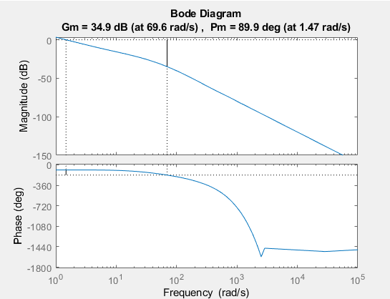
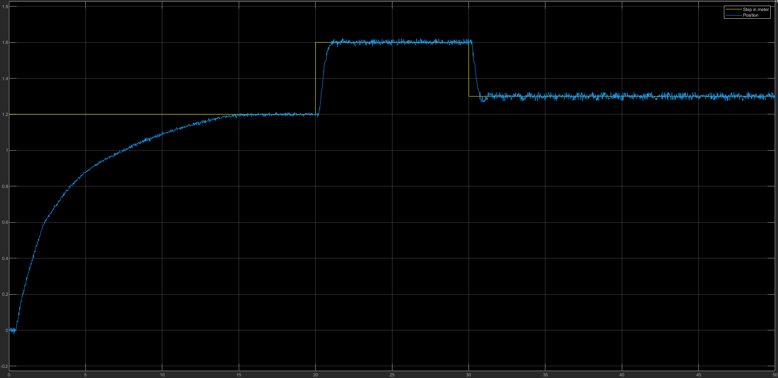
Outer loop – PD regulation
Checking the phase and gain margin of this PD regulator with the ZOH
Test of the PD regulator on the model
Test of the PD regulator on the plant
Gain and phase margin are above the usual values of 6dB and 30 degrees
The plant and the model both respects all requirements but in the plant lots of noise appears at 1.3m which is probably due to the limit of the sensor linear zones

Slide 19
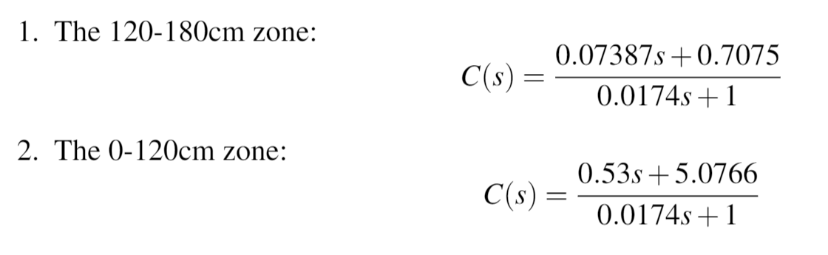
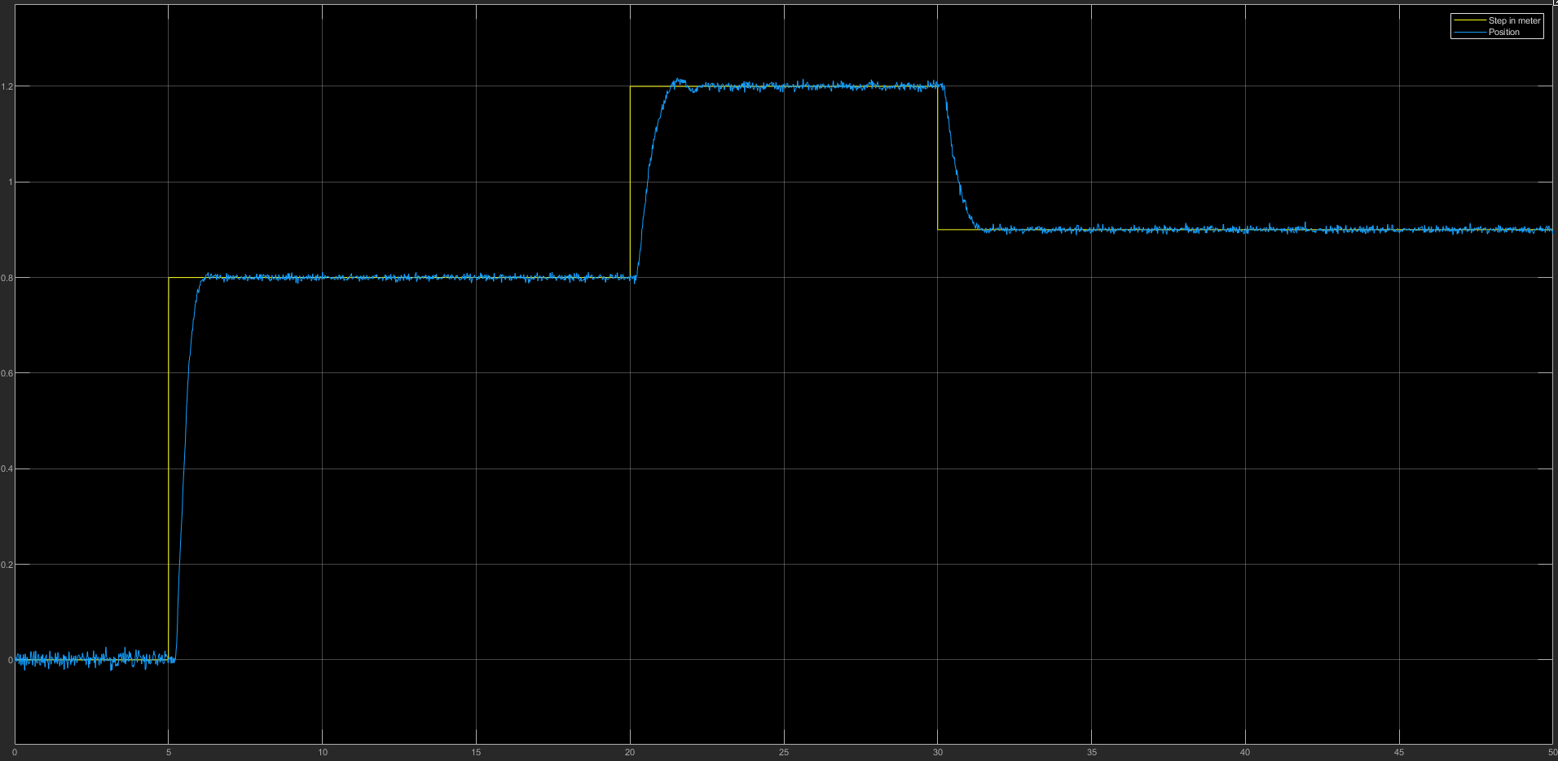
Extension to full tube
To take into account the change of slope in the 0-120 cm zone, another regulation was designed using an overshoot percentage of 0,833% and the sensor gain of 1.083
We thus found have 2 different regulations to control the full tube
Which gave us a gain of 5.0766 and this regulation on the plant

Slide 20
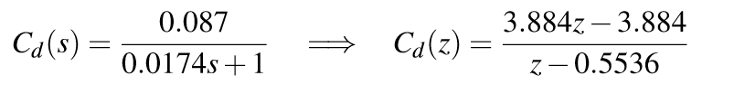
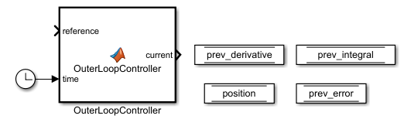
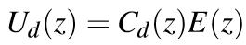


Implementation
Discrete-time regulation needs to be implemented
The previous derivative regulator is transformed in its z-form using c2d
As we know that
Matlab function is used with a sampling time of 0.01s

Slide 21



Implementation
The value of Kp is adapted depending on the ball position at the beginning of the code
The error is the difference between the real position and the reference
Comparison of CT and DT PD regulation
The next input is computed by
At which the equilibrium value is added

Slide 22

Discussion
Further improvement would be a third regulator or a filter to respect the requirements in the 130-150cm zone in which noise appears
Our interpretation of this noise is that it comes from the non linearity of the sensor in that zone

Slide 23

Q&A

Slide 25


Codes

Slide 26

Codes

